Slide 1
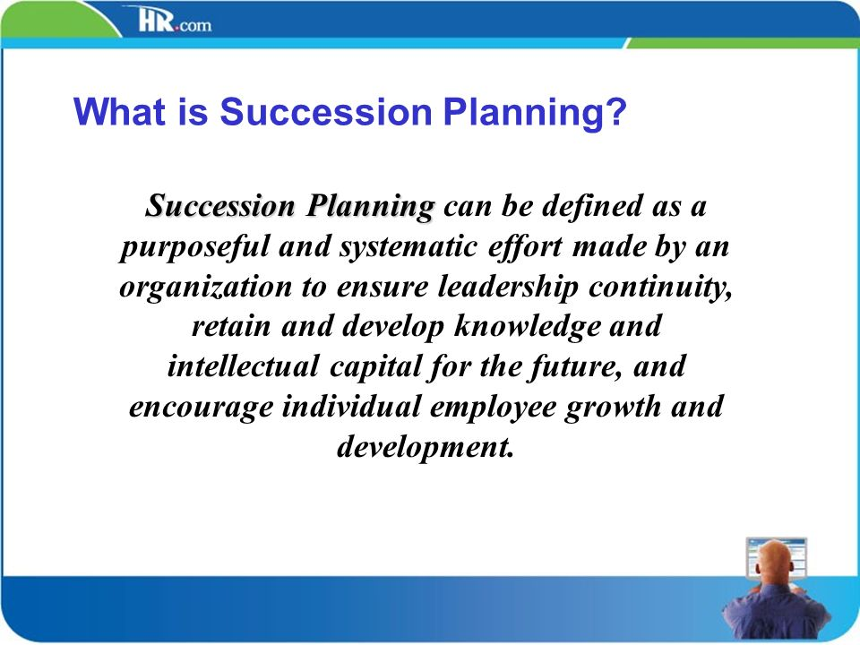
Chapter 15 The Final Harvest of a New Venture

Slide 2
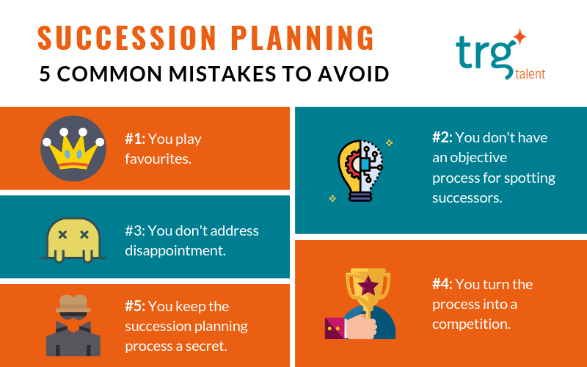

Slide 3
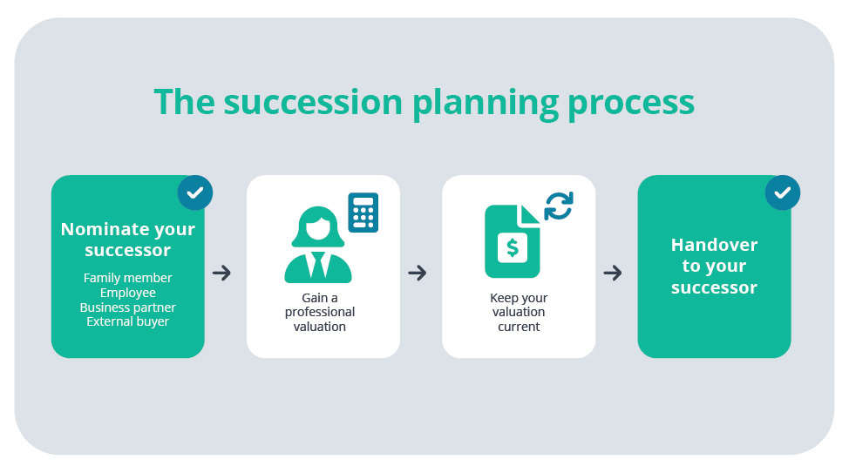

Slide 4
Events / Forces (replacement of owner / manger)
Death.
Illness.
Mental / psychological breakdown.
Abrupt departure.
Legal problems.
Severe business decline.
Financial difficulties.

Slide 5
Sources of Succession (which one you think is the best)
Inside owner’s family and inside the organization.
Inside owner’s family and outside the organization.
Outside owner’s family and Inside the organization.
Outside owner’s family and Outside the organization.

Slide 6
Developing a Succession Strategy (Several Important Steps)
Understanding the contextual aspects
Time
Type of venture
Capabilities of the manager
Entrepreneur’s vision
Environmental factors
Identifying successor qualities
Developing a written succession plan (A written policy can be established using one of the following strategies)
The owner controls the management continuity strategy entirely.
The owner consults with selected family members.
The owner works with professional advisors.
The owner works with family involvement.
The owner formulates buy / sell agreements at the very outset of the company.
The owner considers employee stock ownership plans.
The owner sells or liquidates the business when losing enthusiasm.
The owner sells or liquidates after discovering a terminal illness.

Slide 7
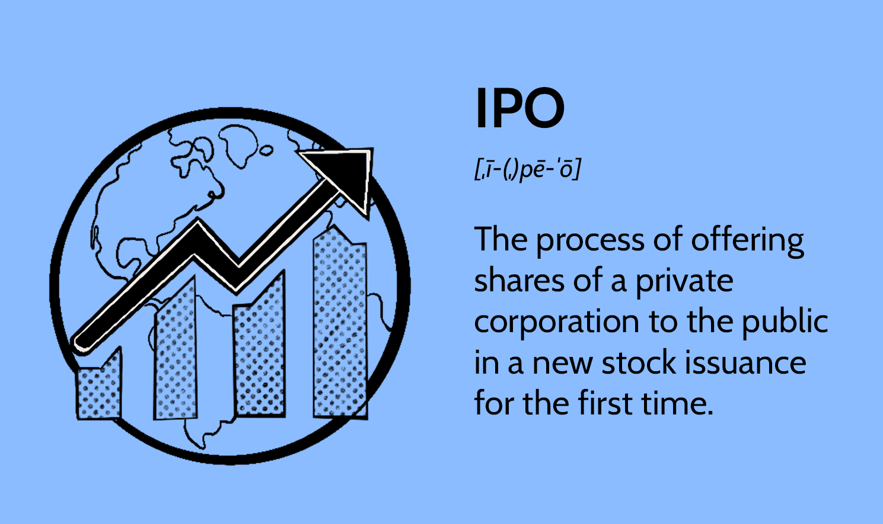

Slide 8
Complete Sale of the Venture (steps for selling a business)
Step 1 : prepare a financial analysis
Step 2 : segregate assets (for taxation purpose) (consult tax accountants and lawyers)
Step 3 : value the business.
Step 4 : identify the appropriate timing
Sell when business profits show a strong upward trend.
Sell when the management team is complete and experienced.
Sell when the business cycle is on the upswing.
Well when you are convinced that your company’s future will be bright.
Step 5 : publicize the offer to sell
Step 6 : Finalize the prospective buyers
Step 7 : Remain involved through the closing
Step 8 : Communicate after the sale.

Slide 9


